Slide 1


BUILDING A COMPILER FOR DOMAIN SPECIFIC LANGUAGES(DSL) USING DEEP LEARNING
T.Rechan reddy (192211812),
Sk.Sohail(192210074),
N.Vamsi Chowdari(192210317).

Slide 2



Introduction to Domain Specific Languages (DSLs)
Domain Specific Languages (DSLs) are specialized programming languages designed to address the unique requirements of a specific problem domain. They provide a concise and expressive syntax tailored to the needs of domain experts, enabling them to write code more efficiently and effectively.

Slide 3

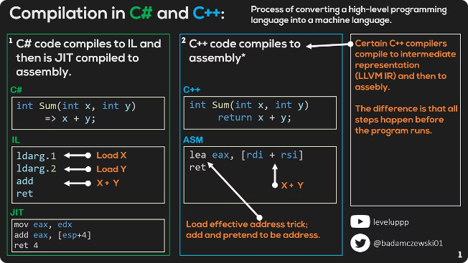
Challenges in Building Compilers for DSLs
1
Syntax Design
2
Semantic Complexity
Crafting a user-friendly syntax that balances expressiveness and simplicity is crucial for DSLs.
Capturing the nuanced semantics of a domain can be a significant challenge, requiring deep domain knowledge.
3
Performance Optimization
Ensuring efficient execution of DSL programs while preserving the domain-specific abstractions is a key concern.

Slide 4
Overview of Deep Learning Techniques
Neural Networks
Convolutional Networks
Recurrent Networks
The foundational building blocks of deep learning, capable of modeling complex patterns in data.
Specialized for processing spatial data, such as images, with applications in computer vision.
Designed for sequential data, like text and speech, enabling the modeling of temporal dependencies.

Slide 5

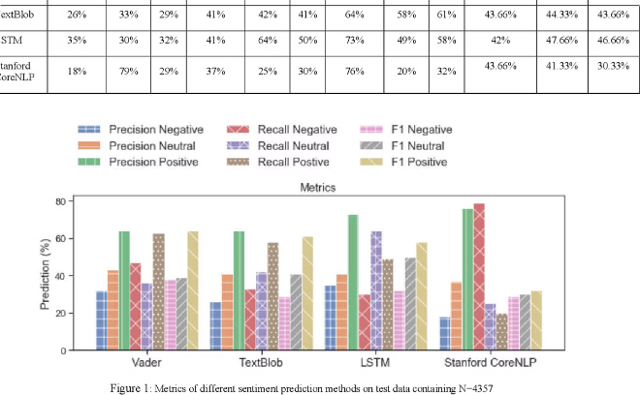
Leveraging Deep Learning for Lexical Analysis
1
Token Identification
Using neural networks to accurately recognize and classify the basic lexical elements of the DSL.
2
Contextual Understanding
Leveraging deep learning techniques to capture the semantic meaning of tokens based on their context.
3
Error Detection
Applying deep learning models to identify and localize lexical errors within the DSL code.

Slide 6

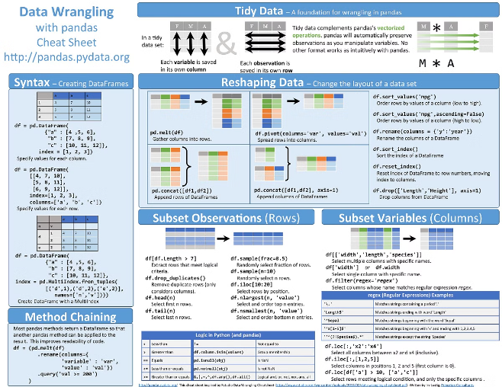



Applying Deep Learning for Syntactic Analysis
Parse Tree Generation
Utilizing deep learning models to construct the syntactic structure of DSL programs.
Syntax Error Identification
Leveraging deep learning techniques to detect and pinpoint syntax-related errors in the DSL code.
Automated Refactoring
Applying deep learning to suggest and implement syntactic improvements to the DSL programs.

Slide 7


Deep Learning Based Semantic Analysis
Domain Modeling
Type Inference
Applying deep learning techniques to infer the type information of DSL program elements.
Using deep learning to capture the intricate semantic relationships within the target domain of the DSL.
Logical Reasoning
Automated Optimization
Leveraging deep learning to enable logical reasoning and validation of DSL program semantics.
Utilizing deep learning to optimize the semantic structure of DSL programs for improved performance.

Slide 8

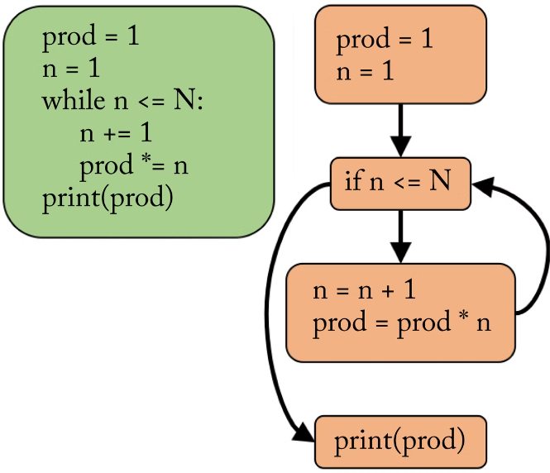



Optimizing the Compiler with Deep Learning
Code Generation
Leveraging deep learning to generate efficient target code from the DSL program representation.
Memory Management
Applying deep learning techniques to optimize memory usage and reduce resource consumption.
Compiler Performance
Using deep learning to improve the overall speed and efficiency of the compiler for the DSL.

Slide 9

Conclusion and Future Directions
Conclusion
The integration of deep learning techniques has the potential to revolutionize the development of compilers for domain-specific languages, enabling more powerful, efficient, and user-friendly solutions.
Future Directions
Continued research and advancements in areas like interpretable deep learning, multi-task learning, and end-to-end compiler optimization will further enhance the capabilities of deep learning-based DSL compilers.

Slide 10
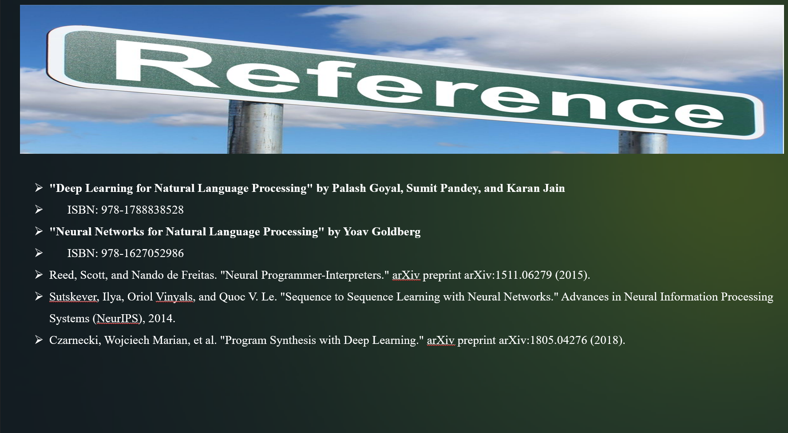

Slide 11


